Slide 1
The Pre-Socratics Dr. Stephanie Spoto sspoto@mpc.edu Monterey Peninsula College
Gentrain
27 September 2018

Slide 2
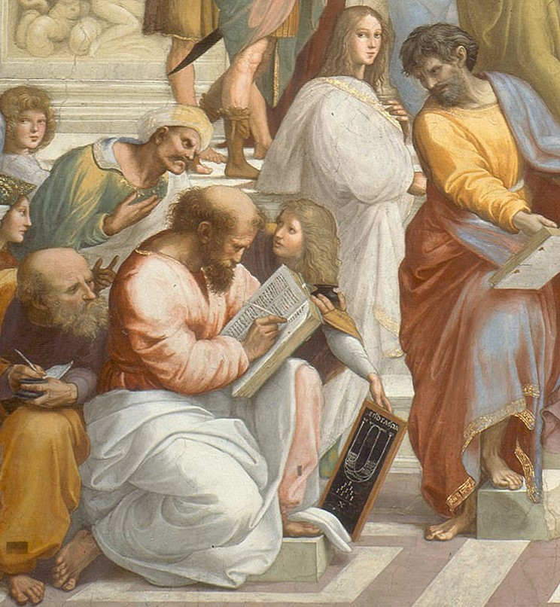
The Pre-Socratics A turn to rationality
The term “pre-Socratics” is a term generally used to refer to some of the earliest philosophers in Greek antiquity
Beginning in the 6th century BCE
Sought explanations based on rational principles rather than looking towards the gods or the supernatural
Pioneered the idea in Greece that the world was a well ordered kosmos → can be understood rationally
In Raphael's fresco The School of Athens, Pythagoras is shown writing in a book as a young man presents him with a tablet showing a diagrammatic representation of a lyre above a drawing of the sacred tetractys. 1511.

Slide 3
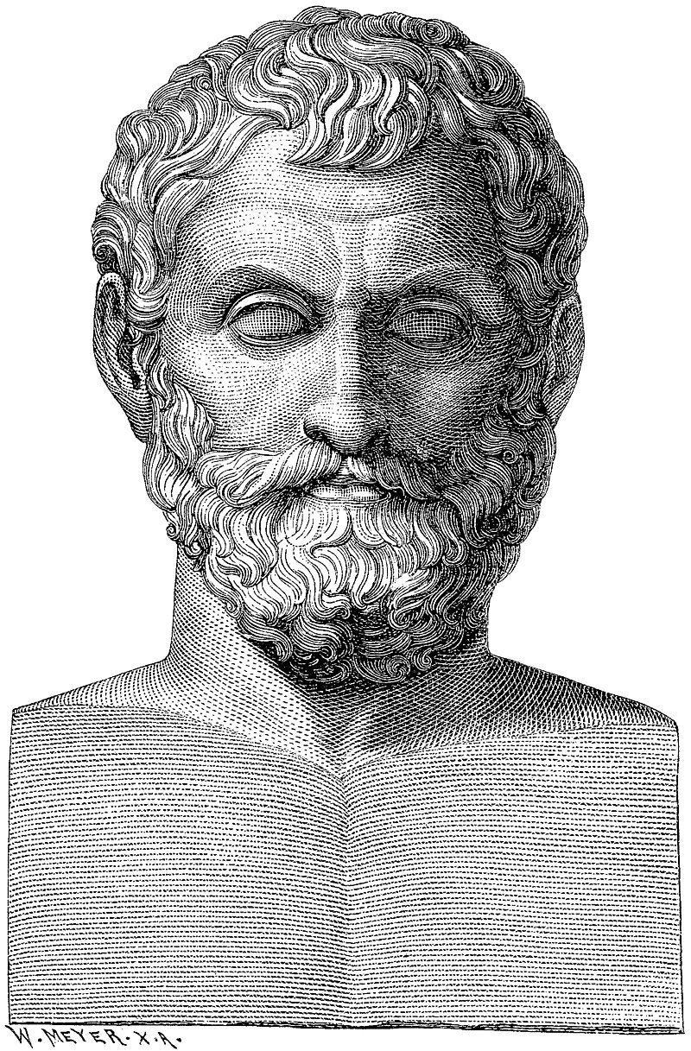
Terminology
In classical antiquity, the pre-Socratic philosophers were called physiologoi (Greek: φυσιολόγοι; in English, physical or natural philosophers)
Aristotle the first to distinguish between what he saw as two types of philosophers:
physiologoi or physikoi: ("physicists", after physis, "nature") → looked for natural, physical explanations for events, phenomena
theologoi (theologians), or mythologoi (bards) → saw in natural events the agency or impact of the gods
Illustration from "Illustrerad verldshistoria utgifven av E. Wallis. volume I": Thales. 1875.

Slide 4
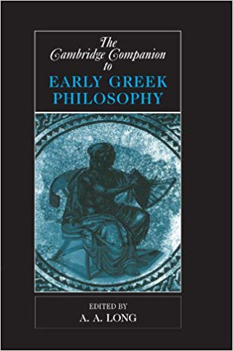
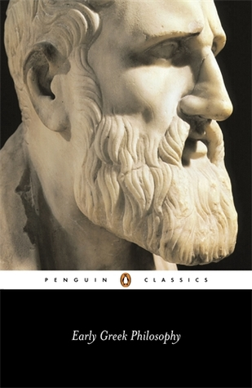
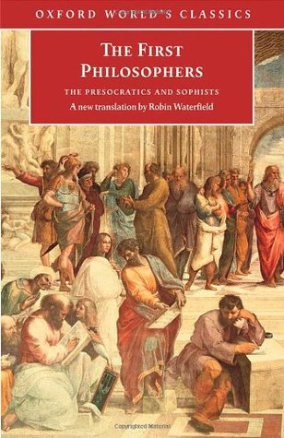
Sources
Doxography: accounts told through other sources → accounts of pre-Socratics related mostly through the works of later philosophers, such as Aristotle, Diogenes Laërtius, Stobaeus and theologists such as Clement of Alexandria and Hippolytus of Rome.

Slide 5
Questioning the Universe Scientifically
Rejecting mythological explanations for the universe, they were concerned with finding material and physical explanations to philosophical questions:
Where does the universe and all matter come from?
What constitutes the material of the universe?
Why are there so many things? (the “plurality of nature”)
How can we use mathematics do discover truth in nature?

Slide 6
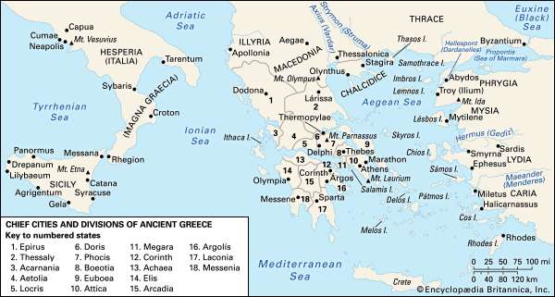
Four major pre-Socratic schools
Milesian School → named for the location of its founding: Miletus (Ionia, modern day Anatolia), 7th century BCE
Pythagorean School → named for Pythagoras, popularized where he taught, in Croton (southern Italy), 6th century BCE
Eleatic School → formed by Parmenides and Zeno and named for the place of its location: Elea (southern Italy), 6th and 5th centuries BCE
Atomist School → founded by Leucippus of Miletus (5th Century B.C.) and his famous pupil Democritus

Slide 7
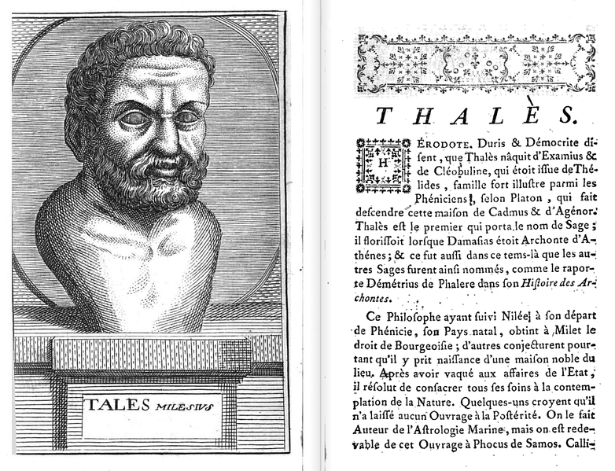
Milesian School
According to Aristotle’s Metaphysics, the Milesian School was founded by Thales of Miletus, 7th century BCE
Thales of Miletus often called the father of Western philosophy
Beginnings of a new school of thought which claimed that fate was not in the hands of the gods, but the result of natural phenomena.
The world composed of entities, which can be studied and understood
Scientific approach to the study of nature → predicting solstices and eclipses.
First Greeks to use the stars as a navigation tool
Thales of Miletus
-Doctrine of water
Anaximenes
-Doctrine of air
Anaximander
-Earliest scientific experiments
-"apeiron“ – infinite, boundless

Slide 8
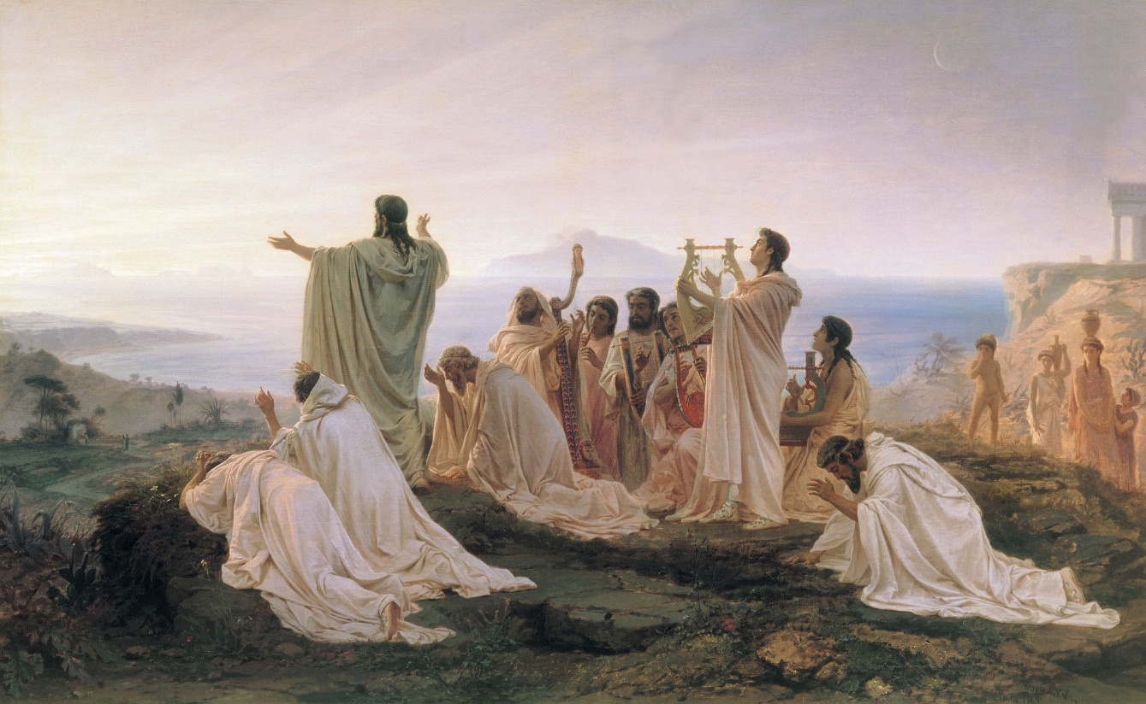
Pythagorean School
Pythagoreans celebrate sunrise, 1869 painting by Fyodor Bronnikov.
Both idealistic and materialistic: the universe is a whole, but matter can be understood independently
Became more idealistic → physical body enclosing the psyche and the eternal soul (life after death)
Mathematics and mysticism: led to two distinct threads of Pythagoreanism
The universe is made up of “aperion” – it “inhaled the void” outside, separating the universe into parts
Underlying truth of the universe found in mathematics → developed mathematical theories related to prime

Slide 9
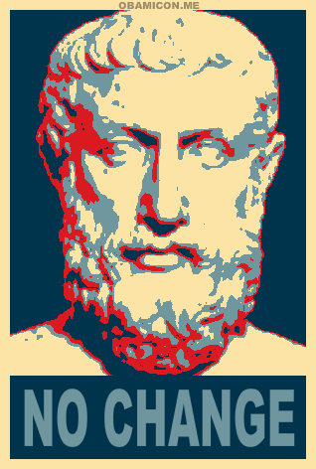
Eleatic School
Xenophanes: criticized the belief in many gods, which was the dominant belief → world is “one being” that is timeless and changeless
Later became adherent of the dualism of appearance and reality which would influence metaphysics and Platonism
Zeno of Elea: paradoxes; Aristotle called him the creator of the dialectic; called the founder of modern logic by Bertrand Russell
Rejected sense experience → knowledge comes through reason and logic

Slide 10
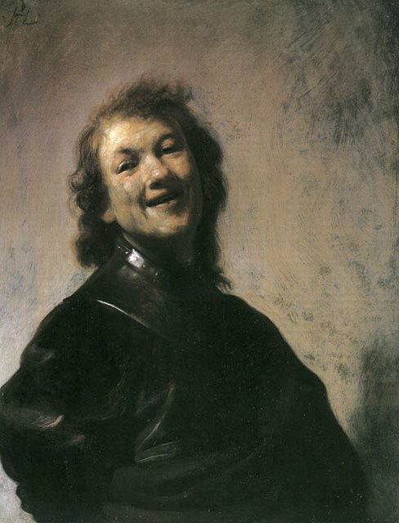
The Atomist School
Hidden substance of all objects is atoms and void
Moving through the void, these atoms collide and unify creating objects
Most information we have about this school is in fragments or contradictory
Aristotle outlines some claims of Atomism → saw it as a rival school of natural philosophy
Epicurus studied Atomism (c. 325 BCE), and believed in the fundamental nature of atoms, but has less sure that he could predict natural phenomena with this knowledge → founded his own school
Atomism influence Lucretius (c. 99 - 55 B.C.) whose On the Order of Things combines both Atomism and Epicureanism
Universe and substance is eternal
Soul made of atoms which dissipate when a person dies
Rembrandt, The Young Rembrandt as Democritus the Laughing Philosopher (1628-29)

Slide 11
The Legacy of the Pre-Socratics
The first scientists → changed the way that people critically examined the world around themselves
Applied by Socrates in his examination of human behavior and institutions
German philosopher, Hegel (d. 1831), credits the Atomists for his theory of being and non-being.
Karl Marx’s doctoral thesis explores the material basis of the universe through atomism
Calls atomists the first materialists

Slide 12
Next week
THE SOPHISTS!! ☺

